Slide 1

Facial Keypoint Recognition
Thursday, April 24, 2019
Krithika Vellore Prabhakar
Dikshya Mohanty

Slide 2
Introduction
The goal of this project is to apply CNN models to label the key points on a grayscale photograph of a human face.
Important why?
tracking faces in images and video
analysing facial expressions
detecting dysmorphic facial signs for medical diagnosis
biometrics / face recognition

Slide 3
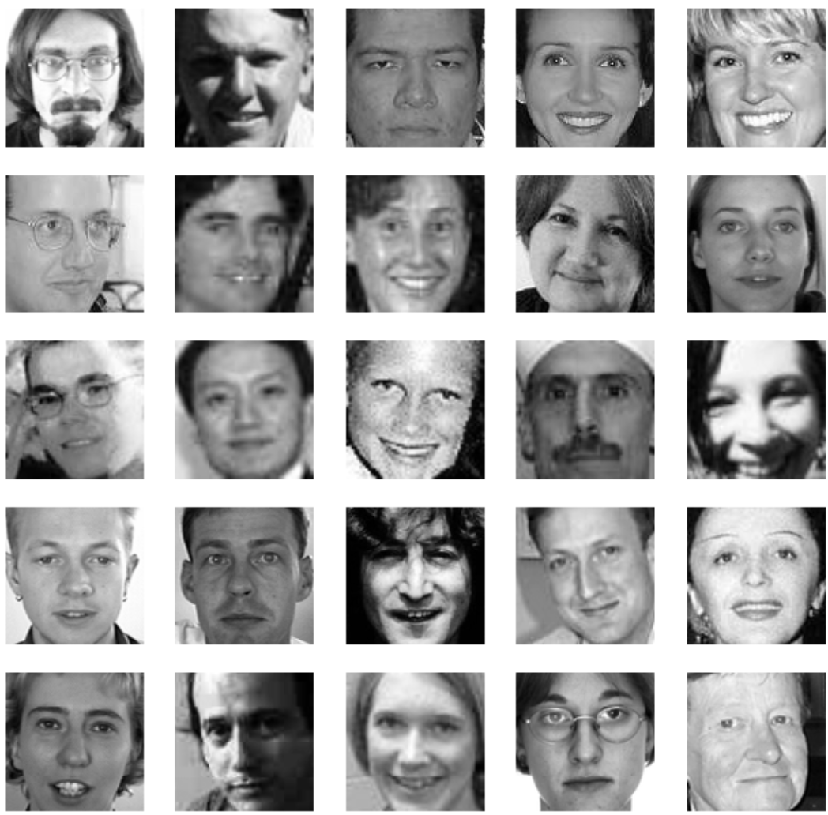
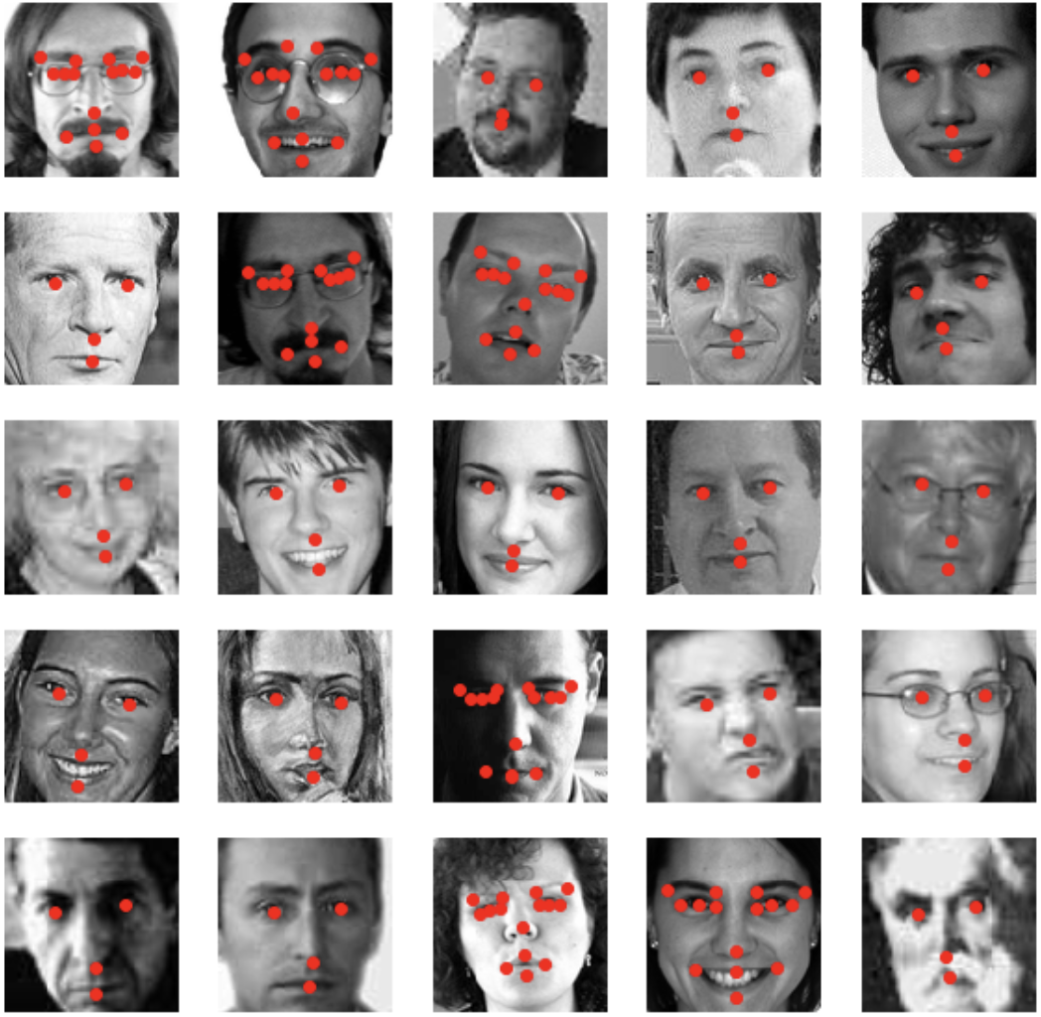
Keypoints: left_eye_center, right_eye_center, left_eye_inner_corner, left_eye_outer_corner, right_eye_inner_corner, right_eye_outer_corner, left_eyebrow_inner_end, left_eyebrow_outer_end, right_eyebrow_inner_end, right_eyebrow_outer_end, nose_tip, mouth_left_corner, mouth_right_corner, mouth_center_top_lip, mouth_center_bottom_lip

Slide 4
Data
The input image is given in the last field of the data files, and consists of a list of pixels (ordered by row), as integers in (0,255). The images are 96x96 pixels. The data given are three parts:
1) training.csv: This is the file of list of 7049 images, where each row contains the (x,y) coordinates for the 15 key points. The image data is in row-ordered list of pixels .
2) test.csv: This is the file of list of 1783 test images. Each row contains image ID and image data as row-ordered list of pixels.
3) SampleSubmission: This is the file of the list of 27124 key points to predict. Each row in the file contains a row ID, image ID, feature name, and location.

Slide 5
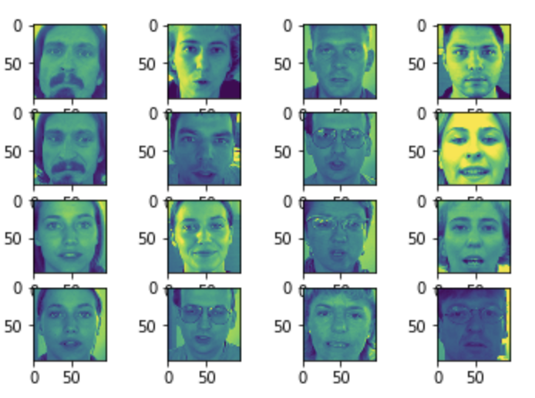
Exploratory Data Analysis

Slide 6
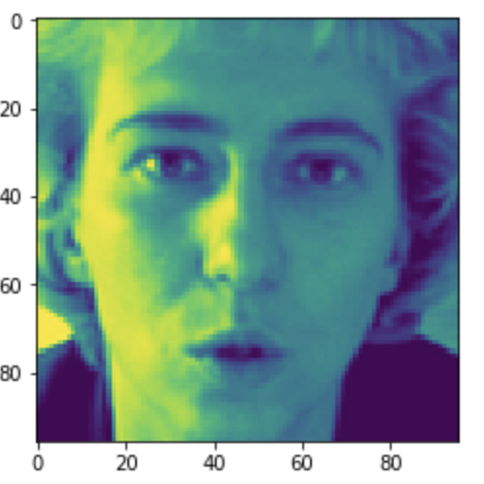
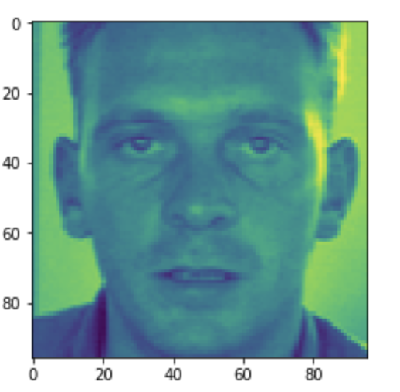
Exploratory Data Analysis

Slide 7
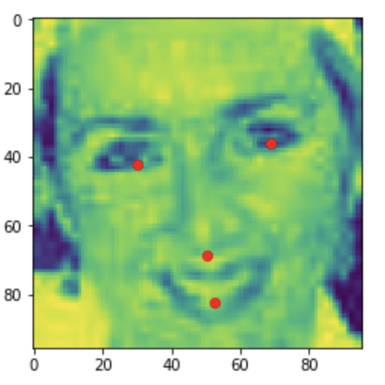
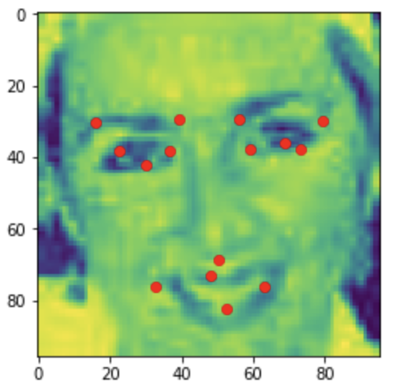
Data preprocessing:
Imputing Missing values:

Slide 8
MODELING
Ensemble model using convolutions, max pooling, dropouts, and fully connected layers.
CONV2D -> RELU -> MAXPOOL -> CONV2D -> RELU -> MAXPOOL -> CONV2D -> RELU -> MAXPOOL -> CONV2D -> RELU -> MAXPOOL -> CONV2D -> RELU -> MAXPOOL -> FLATTEN -> FULLY CONNECTED with DROPOUT REGULARIZATION -> OUTPUT

Slide 9
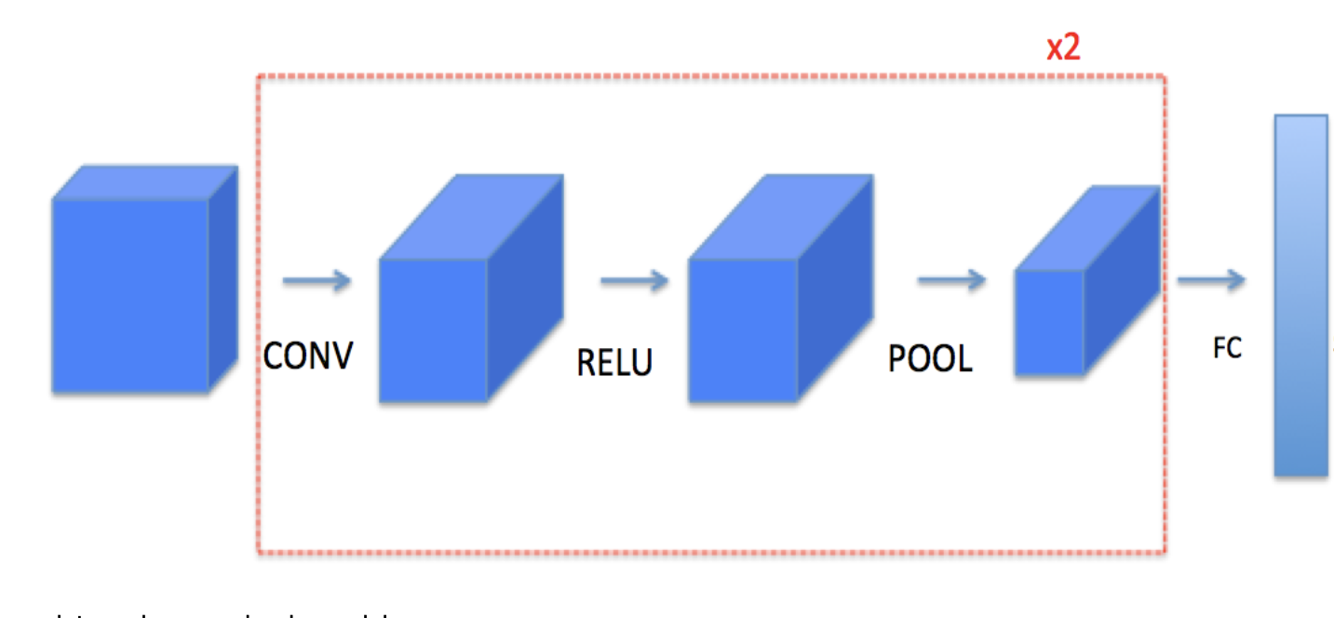
MODELING

Slide 10
Tasks performed
Create placeholders
Initialize parameters
Forward propagate
Compute the cost
Create an optimizer
Cost function: We have implemented the compute cost function using simple squared error. Assumption : Every observation is independent of each other.
Optimizer: Adam optimizer for faster convergence

Slide 11
Hyperparameter tuning
After training & optimizing, we tested its performance on the validation set.
Tried and tested with different values of the learning_rate, minibatch_size and observe the loss in each of the case.
Finally choose the model which performed best on the validation set and tested it on the test set.

Slide 12
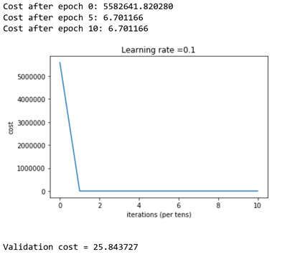
RESULTS:
First session to train the model (Baseline)

Slide 13
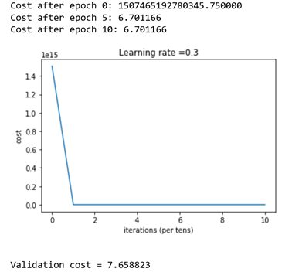
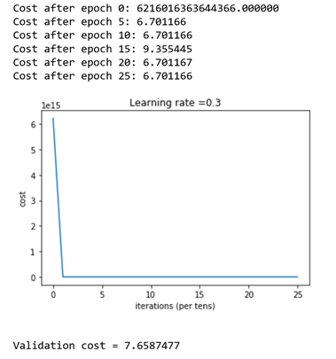
Results of hyperparameter tuning

Slide 14
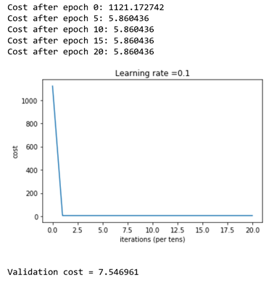
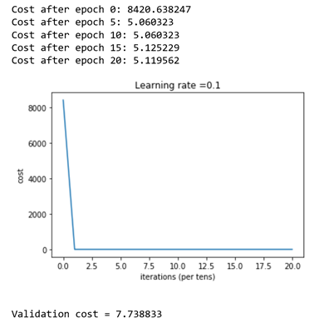
Results of hyperparameter tuning
Increasing batch size and reducing the minibatch size

Slide 15
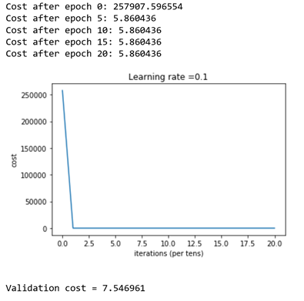
Best Model
Validation cost = 7.546961

Slide 16
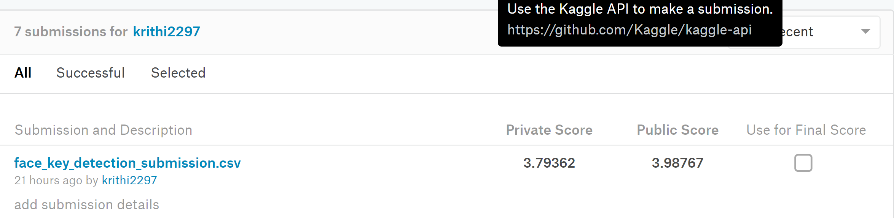
KAGGLE RESULTS
Our best kaggle score public score is 3.98767

Slide 17
References
[1] Facial Keypoint Detection Competition. Kaggle, 7 May 2013. Web. 31 Dec. 2016.
[2] Liang, Lin, et al. “Face alignment via component-based discriminative search.” Computer Vision–ECCV 2008. Springer Berlin Heidelberg, 2008. 72-85.
[3] Amberg, Brian, and Thomas Vetter. “Optimal landmark detection using shape models and branch and bound.” Computer Vision (ICCV), 2011 IEEE International Conference on. IEEE, 2011.
[4] Belhumeur, Peter N., et al. “Localizing parts of faces using a consensus of exemplars.” Pattern Analysis and Machine Intelligence, IEEE Transactions on 35.12 (2013): 2930-2940.
[5] M. Dantone, J. Gall, G. Fanelli, and L. J. V. Gool. Real-time facial feature detection using
conditional regression forests. In Proc. CVPR, 2012.
[6] D. Ciresan, U. Meier, and J. Schmidhuber. Multi-column deep neural networks for image
classification. In Proc. CVPR, 2012
[7] M. Valstar, B. Martinez, X. Binefa, and M. Pantic. Facial point detection using boosted regression and graph models. In Proc. CVPR, 2010.
[8] Sun, Yi, Xiaogang Wang, and Xiaoou Tang. “Deep convolutional network cascade for facial point detection.” Proceedings of the IEEE Conference on Computer Vision and Pattern Recognition. 2013.

Slide 18
Thank You!

